Slide 1
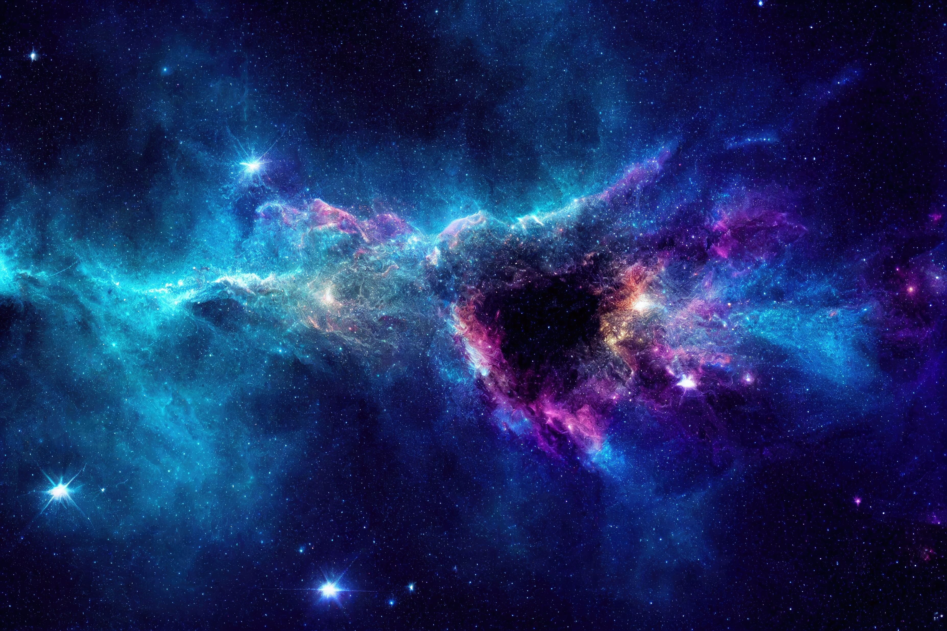

“Across the Cosmic Sea: The Quest to Find Distant Worlds”
CELESTIAL
T E C H Z Z Z

Slide 2
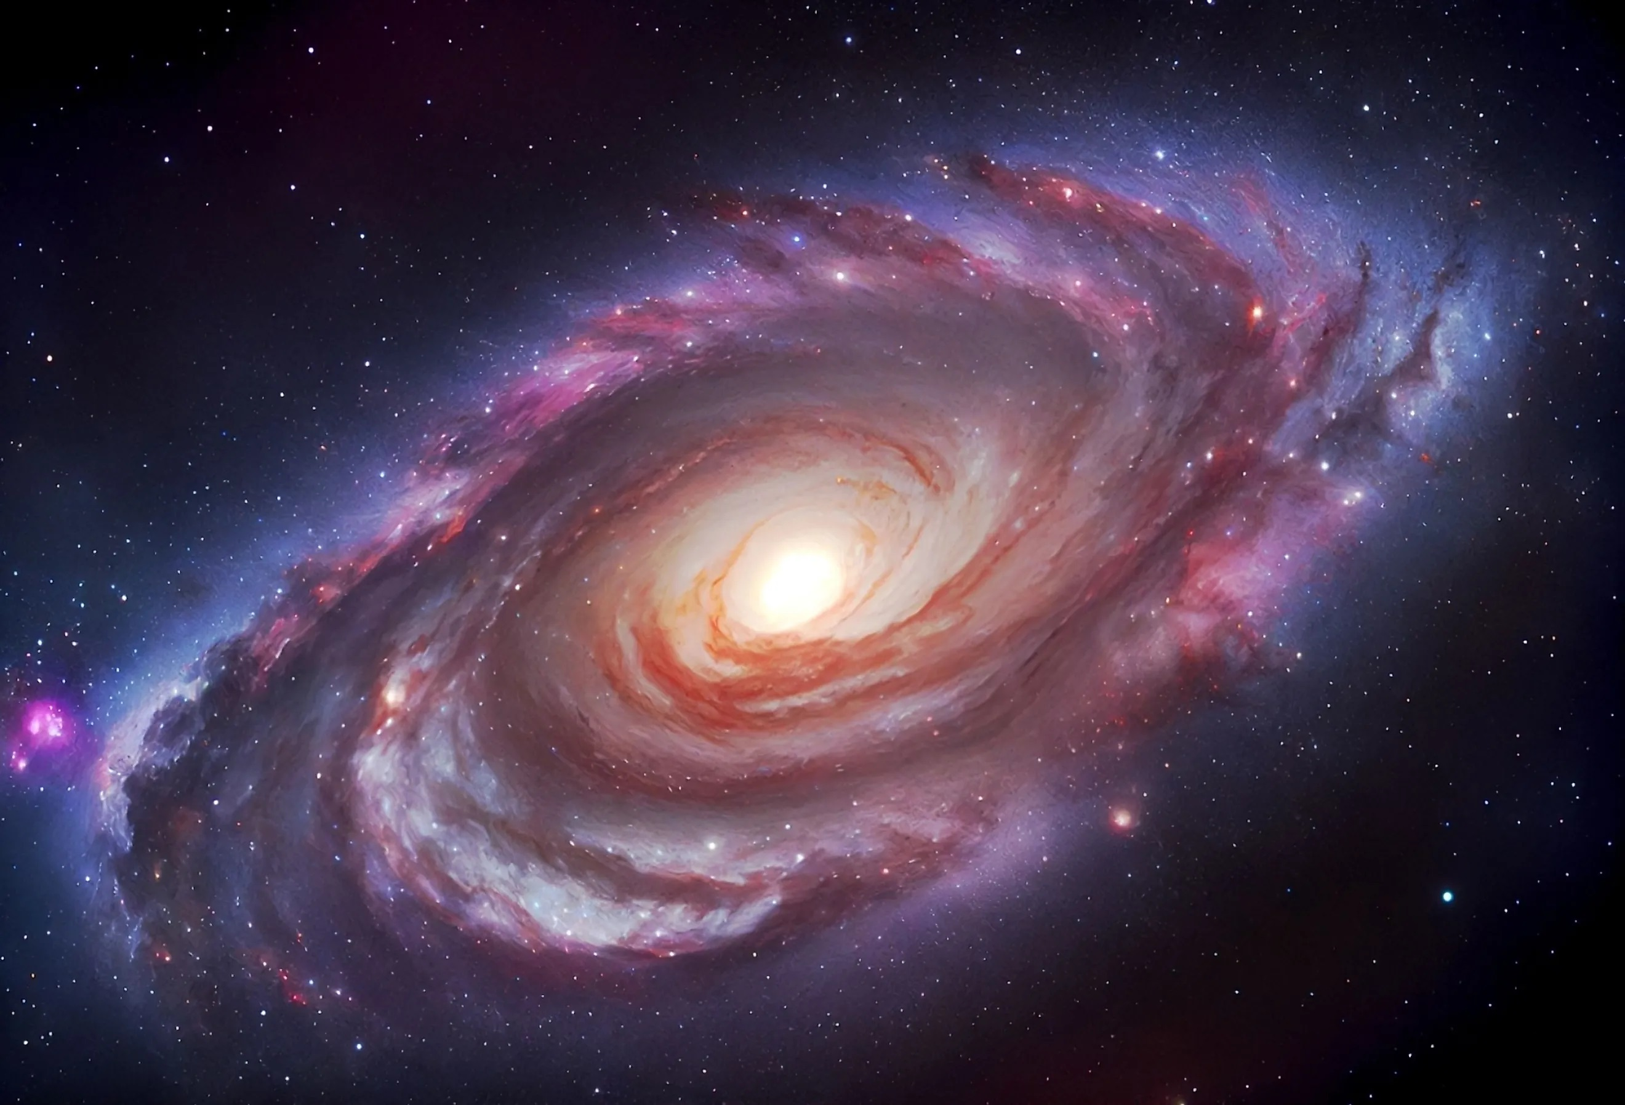


Menu
The milky way is our home galaxy, a vast collection of stars, planets and cosmic dust stretching over 100,000 light-years.

Slide 3
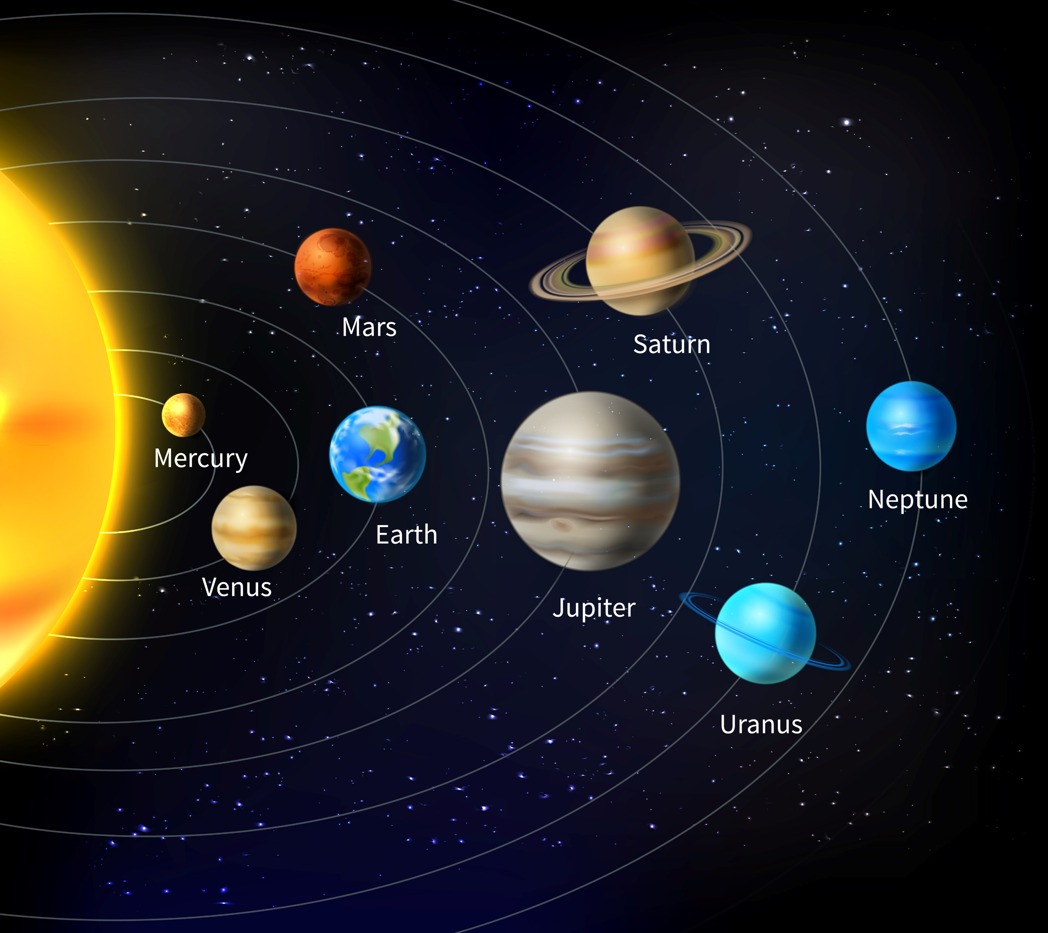
Menu
This is the Solar System, consisting of 8 major planets orbiting our star, the Sun.

Slide 4





Home
Milky Way
Solar System
Dwarf planets
Exo planets

Slide 5
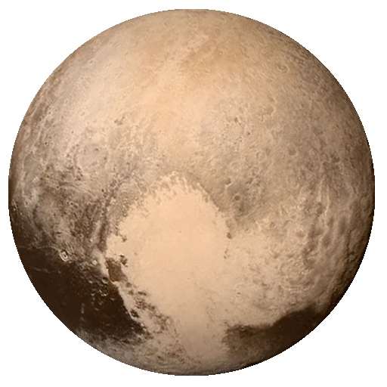
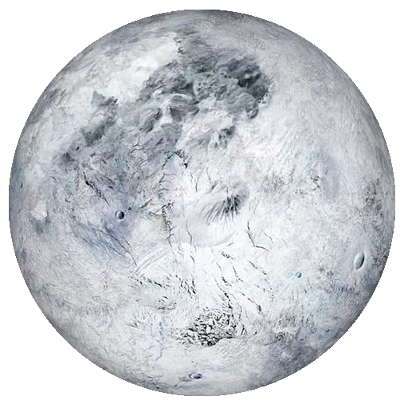
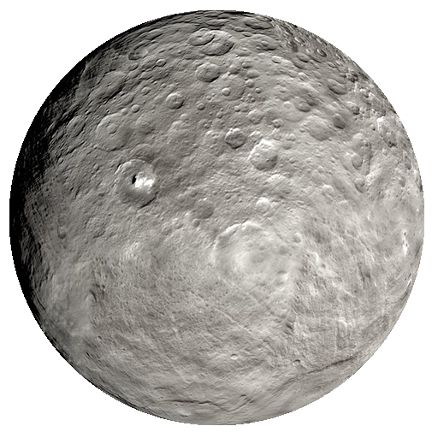
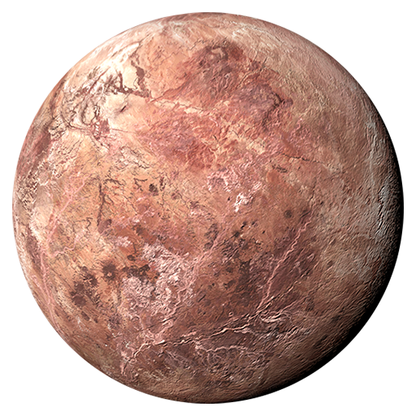
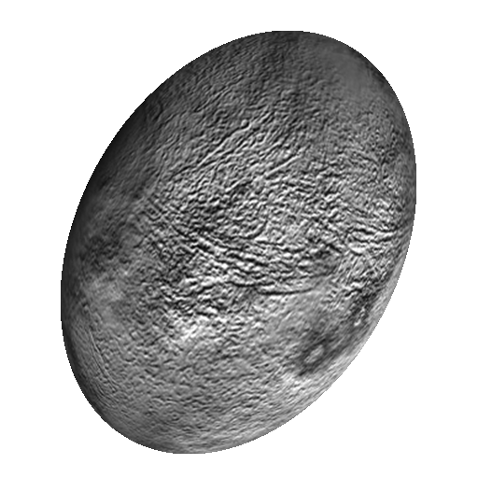
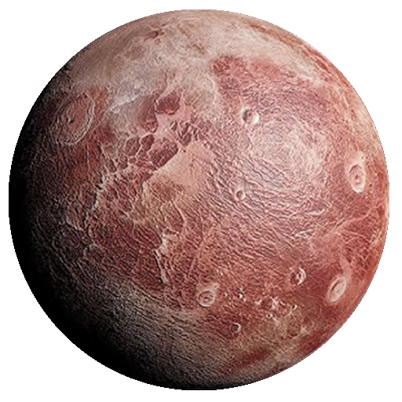
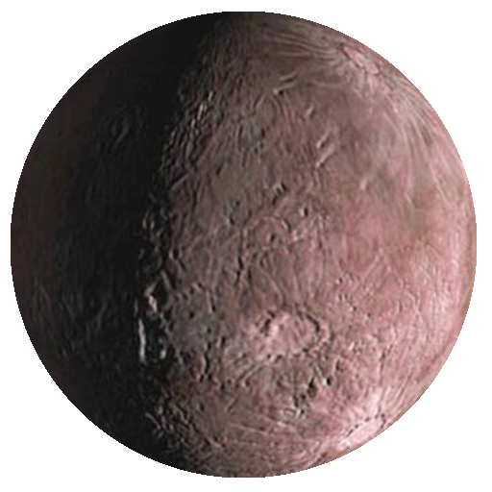
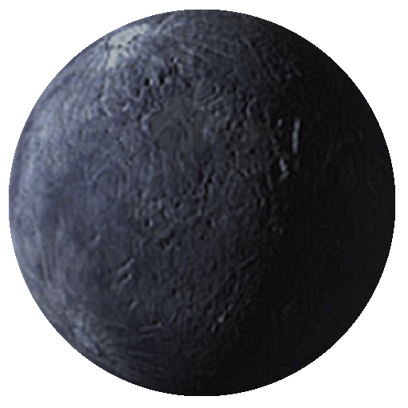
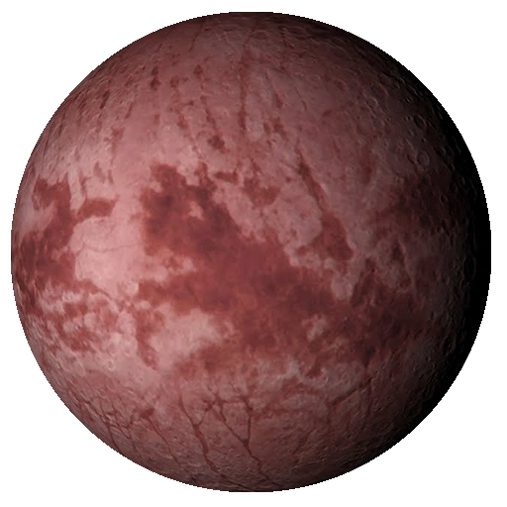
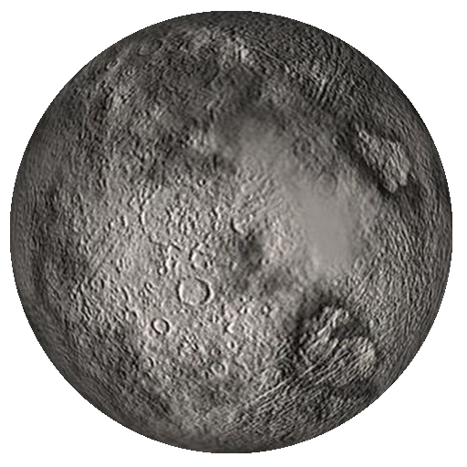
Menu
Pluto
Eris
Ceres
Makemake
Haumea
Gonggong
Quaoar
Orcus
Sedna
Chiron

Slide 7


Menu
Pluto
Once considered the ninth planet, Pluto is now classified as a dwarf planet.
Radius
1151 Kilometers

Slide 9
Menu
Eris
Eris is one of the most massive known dwarf planets in the solar system.
Radius
1163 kilometers

Slide 11
Menu
Ceres
Ceres, located in the asteroid belt , is the largest object between Mars and Jupiter.
Radius
476 kilometers

Slide 13
Menu
Makemake
Makemake is a distant dwarf planet with a reddish colour due to the presence of methane.
Radius
715 kilometers

Slide 15
Menu
Haumea
Haumea is a unique , fast rotating dwarf planet shaped like an ellipsoid.
Radius
620 kilometers

Slide 17
Menu
Gonggong
Gonggong is a distant, large dwarf planet with a mysterious surface.
Radius
1,230 kilometers

Slide 19
Menu
Quaoar
Quaoar is a trans-Neptune object , notable for its large size and distant orbit.
Radius
555 kilometers

Slide 21
Menu
Orcus
Orcus is a distant dwarf planet with a similar orbit to pluto.
Radius
870 to 960 Km

Slide 23
Menu
Sedna
Sedna is one of the farthest objects in our solar system,with a highly elliptical orbit.
Radius
800 and 1,600 Km

Slide 25
Menu
Chiron
Chiron is a minor planet and comet, orbiting between Saturn and Uranus.
Radius
196 kilometers

Slide 26
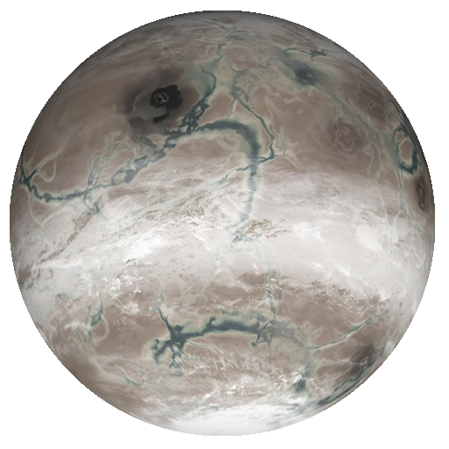
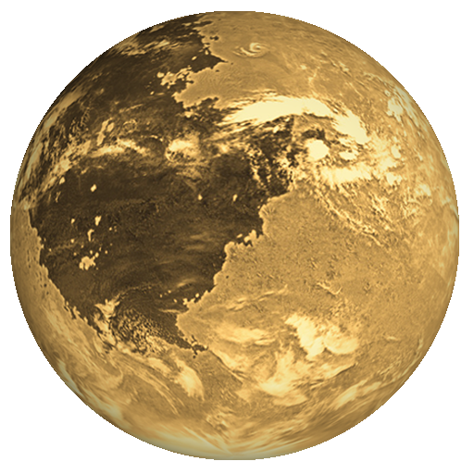
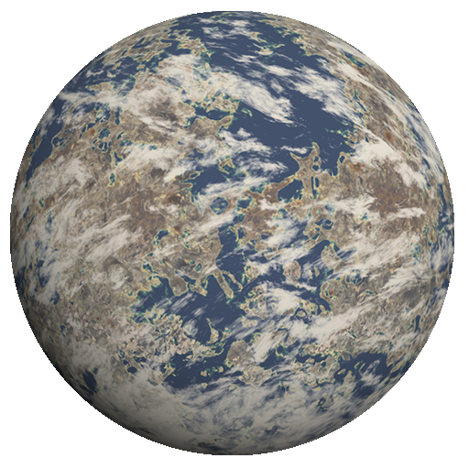
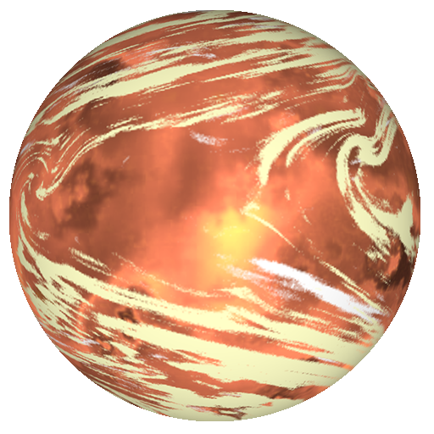

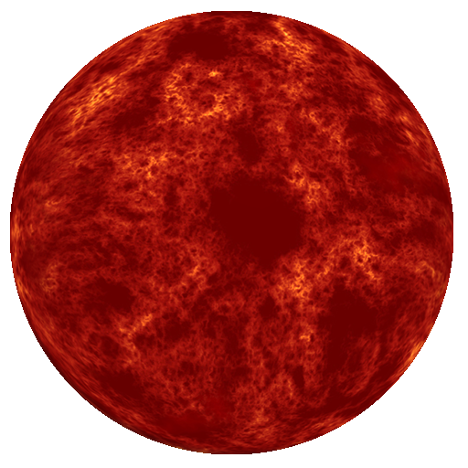
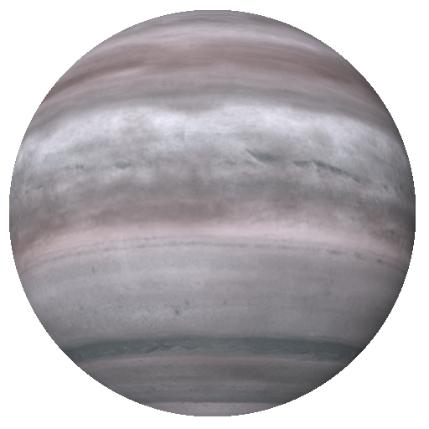
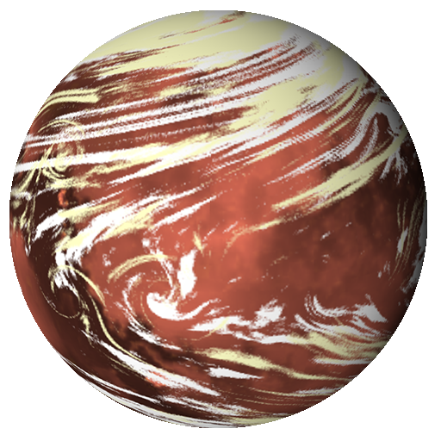
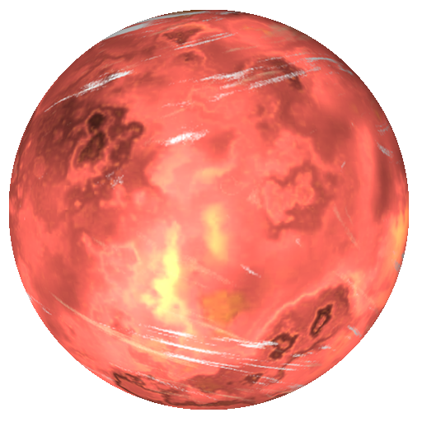
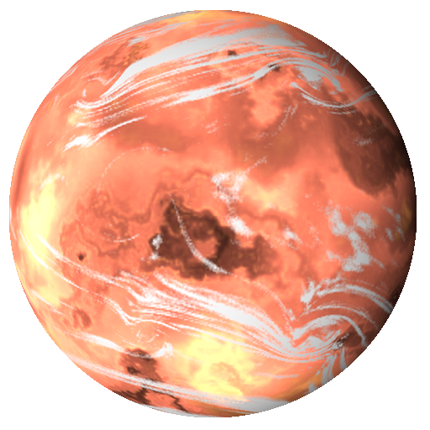
Menu
Kelper-452b
Proxima b
Trappist-1e
K2-18b
Wasp-12b
55 Cancri e
HD 209458b
LHS 1140b
Ross128b
Gliese 667 Cc

Slide 28
Menu
Kepler-452 b
An "Earth-cousin" that orbits a star like our sun in the habitable zone, where liquid water could exist.
Planet Radius
Planet Type
Planet Mass
Orbital Radius
Orbital Period
1.63 x Earth
Super Earth
3.29 Earths
1.046 AU
384.8 days

Slide 30
Menu
Proxima b
Proxima Centauri b is a super Earth exoplanet that orbits an M-type star. Its mass is 1.07 Earths, it takes 11.2 days to complete one orbit of its star , and is 0.04856 AU from its star. Its discovery was announced in 2016.
Planet Radius
Planet Type
Planet Mass
Orbital Radius
Orbital Period
1.03 x Earth
Super Earth
1.07 Earths
0.04856 AU
1.2 days

Slide 32
Menu
Trappist-1e
TRAPPIST-1 e is a terrestrial exoplanet that orbits an M-type star. Its mass is 0.692 Earths, it takes 6.1 days to complete one orbit of its star, and is 0.02925 AU from its star. Its discovery was announced in 2017..
Planet Radius
Planet Type
Planet Mass
Orbital Radius
Orbital Period
0.92 x Earth
Terrestria
0.692 Earths
0.02925 AU
6.1 days

Slide 34
Menu
K2-18b
K2-18 b is a super Earth exoplanet that orbits an M-type star. Its mass is 8.92 Earths, it takes 32.9 days to complete one orbit of its star, and is 0.1429 AU from its star. Its discovery was announced in 2015.
Planet Radius
Planet Type
Planet Mass
Orbital Radius
Orbital Period
2.37 x Earth
Super Earth
8.92 Earth
0.1429 AU
32.9 days

Slide 36
Menu
55 Cancri e
This super hot world is covered in a global ocean of lava and has sparkling skies.
Planet Radius
Planet Type
Planet Mass
Orbital Radius
Orbital Period
1.875 x Earth
Super Earth
7.99 Earths
0.01544 AU
0.7 days

Slide 38
Menu
Wasp-12b
The doomed planet WASP-12b is a hot Jupiter that orbits so close to its parent star, it's being torn apart. It takes this alien world only 1.1 days to completely circle its sun.
Planet Radius
Planet Type
Planet Mass
Orbital Radius
Orbital Period
1.937xJupiter
Gas Giant
1.465Jupiters
0.0232 AU
1.1 days

Slide 40
Menu
HD 209458b
HD 209458 b is a gas giant exoplanet that orbits an F-type star. Its mass is 0.73 Jupiter, it takes 3.5 days to complete one orbit of its star, and is 0.04707 AU from its star. Its discovery was announced in 1999.
Planet Radius
Planet Type
Planet Mass
Orbital Radius
Orbital Period
1.39 x Jupiter
Gas Giant
0.73Jupiters
0.04707 AU2 AU
3.5 days

Slide 42
Menu
LHS 1140b
LHS 1140 b is a super Earth exoplanet that orbits an M-type star. Its mass is 6.38 Earths, it takes 24.7 days to complete one orbit of its star, and is 0.0957 AU from its star. Its discovery was announced in 2017.
Planet Radius
Planet Type
Planet Mass
Orbital Radius
Orbital Period
1.73 x Earth
Super Earth
5.6 Earths
0.0946 AUAU
24.7 days

Slide 44
Menu
Ross128b
Ross 128 b is a super Earth exoplanet that orbits an M-type star. Its mass is 1.4 Earths, it takes 9.9 days to complete one orbit of its star, and is 0.0496 AU from its star. Its discovery was announced in 2017.
Planet Radius
Planet Type
Planet Mass
Orbital Radius
Orbital Period
1.11 x Earth
Super Earth
1.4 Earths
0.0496 AU
9.9 days

Slide 46
Menu
Gliese 667 Cc
GJ 667 C c is a super Earth exoplanet that orbits an M-type star. Its mass is 3.8 Earths, it takes 28.1 days to complete one orbit of its star, and is 0.125 AU from its star. Its discovery was announced in 2013.
Planet Radius
Planet Type
Planet Mass
Orbital Radius
Orbital Period
1.77 x Earth
Super Earth
3.8 Earths
0.125 AU
28.1 days

